Slide 1
Activity on node
Slides based on example at
http://hafeezrm.hubpages.com/hub/CASE-STUDY---Probability-in-PERT#

Slide 2
The project
In the following example, the ‘project’ involves the construction of a yacht.
This example uses multiple predictions of activity duration – hence 3PE is used to calculate the new duration.
If only, one duration is given, then use that instead

Slide 3
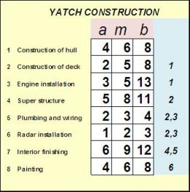
The activities
Activity
Prerequisite activity
optimistic | most likely | pessimistic

Slide 4
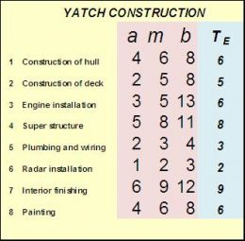
Calculating 3PE
3PE = a + 4m + b
6

Slide 5
Node sections
EARLIEST START TIME | ID NUM [optional] | EARLIEST FINISH TIME
FLOAT/SLACK TIME | DESCRIPTION [optional] | TOTAL FLOAT/SLACK TIME
LATEST START TIME | DURATION | LATEST FINISH TIME

Slide 6
 | 4
 | 1
 | 2
 | 5
 | 7
 | 3
 | 6
 | 8
Draw each activity as a node
Connect each node to its pre-req activity
 | [9]

Slide 7
 | 4
 | 8
 | 1
 | 6
 | 2
 | 5
 | 5
 | 3
 | 7
 | 9
 | 3
 | 6
 | 6
 | 2
 | 8
 | 6
Add durations for each node
 | [9]

Slide 8
Has two incoming activities, so choose larger value
11 | 4 | 19
 | 8
0 | 1 | 6
 | 6
6 | 2 | 11
 | 5
12 | 5 | 15
 | 3
19 | 7 | 28
 | 9
+
6 | 3 | 12
 | 6
12 | 6 | 14
 | 2
14 | 8 | 20
 | 6
Calculate ES and EF times
Start from first node and proceed right
Note that some references start the activity on the following day
28 | [9]

Slide 9
11 | 4 | 19
11 | 8 | 19
Has two incoming activities, so choose smaller value
0 | 1 | 6
0 | 6 | 6
6 | 2 | 11
6 | 5 | 11
12 | 5 | 15
16 | 3 | 19
19 | 7 | 28
19 | 9 | 28
6 | 3 | 12
10 | 6 | 16
12 | 6 | 14
20 | 2 | 22
14 | 8 | 20
22 | 6 | 28
Calculate LF and LS times
Start from end node and work backwards
28 | [9]
—

Slide 10
11 | 4 | 19
 |  | 0
11 | 8 | 19
0 | 1 | 6
 |  | 0
0 | 6 | 6
6 | 2 | 11
 |  | 0
6 | 5 | 11
12 | 5 | 15
 |  | 4
16 | 3 | 19
19 | 7 | 28
 |  | 0
19 | 9 | 28
6 | 3 | 12
 |  | 4
10 | 6 | 16
12 | 6 | 14
 |  | 8
20 | 2 | 22
14 | 8 | 20
 |  | 8
22 | 6 | 28
Calculate Total float TF = LS – ES = LF – EF
28 | [9]

Slide 11
11 | 4 | 19
0 |  | 0
11 | 8 | 19
0 | 1 | 6
0 |  | 0
0 | 6 | 6
6 | 2 | 11
0 |  | 0
6 | 5 | 11
12 | 5 | 15
4 |  | 4
16 | 3 | 19
19 | 7 | 28
0 |  | 0
19 | 9 | 28
6 | 3 | 12
0 |  | 4
10 | 6 | 16
12 | 6 | 14
0 |  | 8
20 | 2 | 22
14 | 8 | 20
8 |  | 8
22 | 6 | 28
Calculate Free float (start to finish) FF = Earliest succeeding activity ES – activity’s EF
[Note there is more than one way to calculate FF – this is probably the easiest]
28 | [9]

Slide 12
